Slide 1
Intro to Stock Market Prediction
Predict Stock Price Using Linear Regression
Alice Stratula & Yi Lu

Slide 2
Theory under the hood
Prediction & Visualize
Overview
Analysis & Summary
The Big Picture
Model Construction

Slide 3
The Big Picture
Objective:
Predict stock price utilizing Linear Regression
Understand linear regression’s fundamental principle
Get a basic understanding about machine learning pipeline
Techniques Needed:
Methodology: Machine Learning Pipeline
Algorithm: Linear Regression
Evaluation & Testing: MSE & Holdout Data Splitting
Analysis on Data
Linear Regression
MSE & Holdout
Predict stock market data
Machine Learning Pipeline

Slide 4






Linear Regression
Line of Best Fit
Provides best estimate of $y$ given $x$.
Answer whether and how some events influences the other or how several variables are related
$y$: response variable (outcome)
$x_{1},x_{2},⋯, x_{n}$: predictor variables (covariates)
The relationship between the outcome and the predictor variable:
$y=f\left(x_{1},x_{2},...,x_{n}\right)+ε$
Example: when we only have one covariate $x$
Dependent Variable:
The variable that we want
to explain
$$y$$
$$R^{2}=0.87$$
Confidence Band:
Datapoints outside these lines can be considered as outliers
$87\%$ of $y$’s variance is explained by $x$.
Below $30\%$: $y$ is hardly explained by $x$.
Above$95\%$:$y$ is very much explained by x
Independent Variable:
The factor might influence
the dependent variable
$$x$$

Slide 5
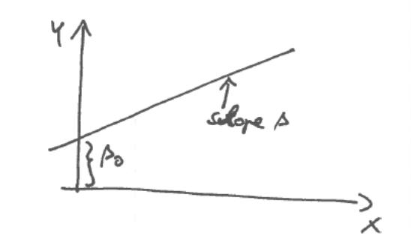
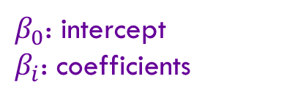
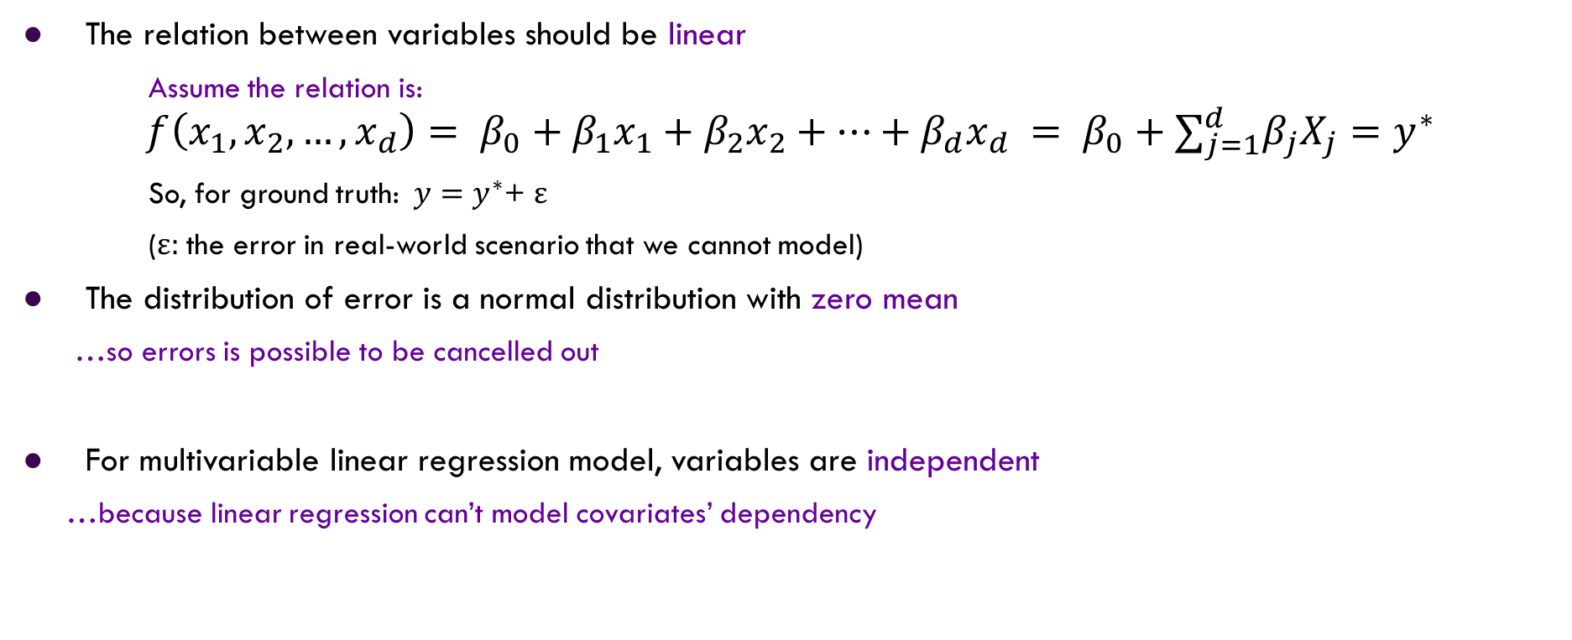
Assumptions in Linear Regression
$β_{0}$: intercept
$β_{i}$: coefficients
The relation between variables should be linear
Assume the relation is:
$$f\left(x_{1},x_{2},…, x_{d}\right)= β_{0}+β_{1}x_{1}+β_{2}x_{2}+…+β_{d}x_{d} = β_{0}+∑_{j=1}^{d}β_{j}X_{j}=y^{∗}$$
So, for ground truth:$y=$ $y^{∗}$+ ε
(ε: the error in real-world scenario that we cannot model)
The distribution of error is a normal distribution with zero mean
…so errors is possible to be cancelled out
For multivariable linear regression model, variables are independent
…because linear regression can’t model covariates’ dependency

Slide 6
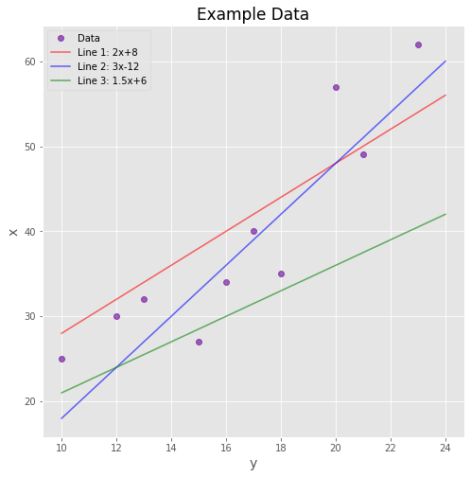
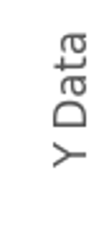
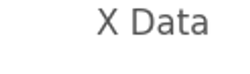

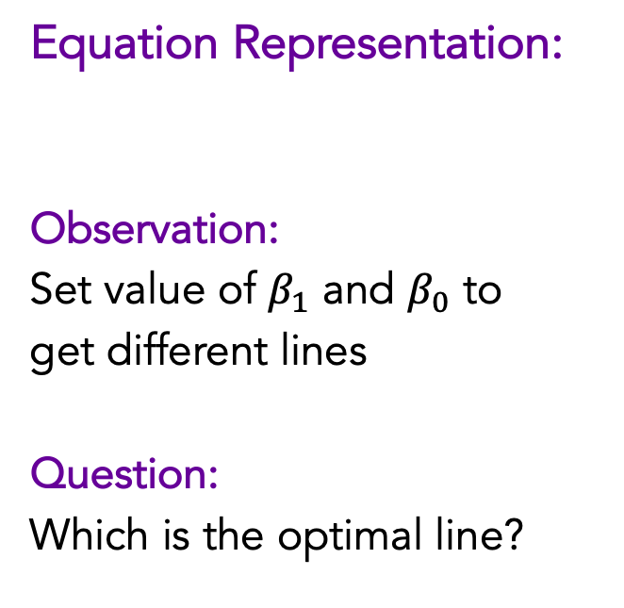
Example: Simple Linear Regression
Equation Representation:
Observation:
Set value of $β_{1}$ and $β_{0}$ to
get different lines
Question:
Which is the optimal line?
$$y=β_{1}x+β_{0}$$

Slide 7
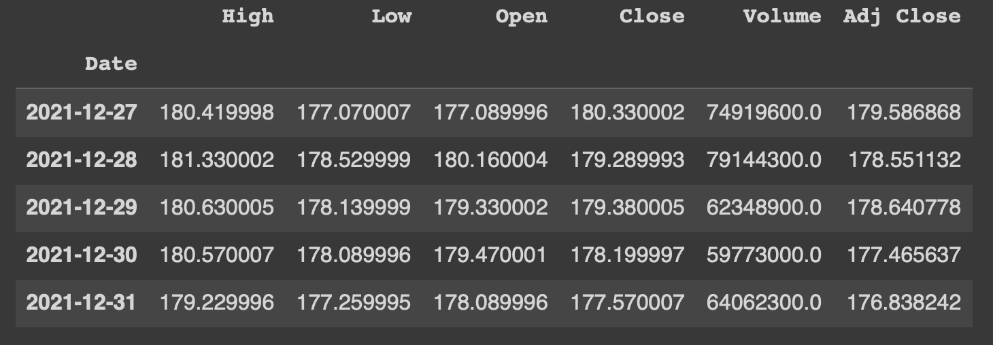



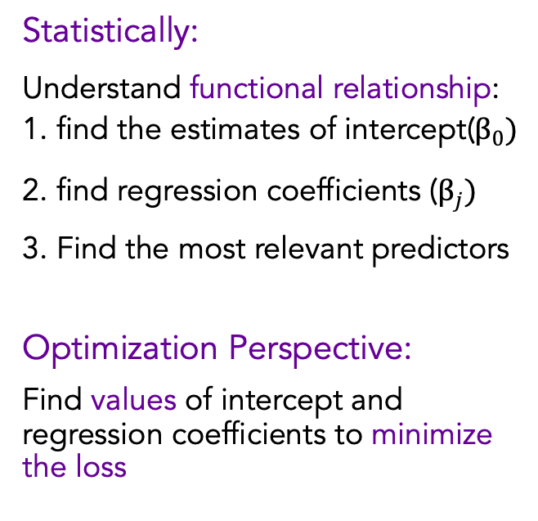



Objective of Linear Regression
Measure of variable importance:
Take High, Low, Open, Close, Volume
Formula:
Close$= β_{1}x_{1}+β_{2}x_{2}+β_{3}x_{3}+β_{4}x_{4}+$ $β_{5}x_{5}+β_{0}$
Which coefficient is the most significant?
$$x_{1}$$
$$x_{2}$$
$$x_{3}$$
$$x_{4}$$
$$x_{5}$$
Statistically:
Understand functional relationship: 1. find the estimates of intercept($β_{0})$
2. find regression coefficients ($β_{j})$
3. Find the most relevant predictors
Optimization Perspective:
Find values of intercept and regression coefficients to minimize the loss

Slide 8
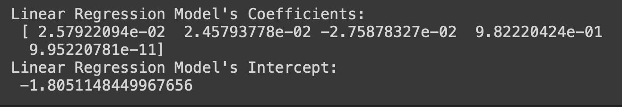
Assume we have the following result:
Now we have our fitted regression equation:
Close$= 0.0258x_{1}+0.0246x_{2}−0.0276x_{3}+0.9822x_{4}+$ $0.00….095x_{5}−1.8051$
Average expected closing price

Slide 9
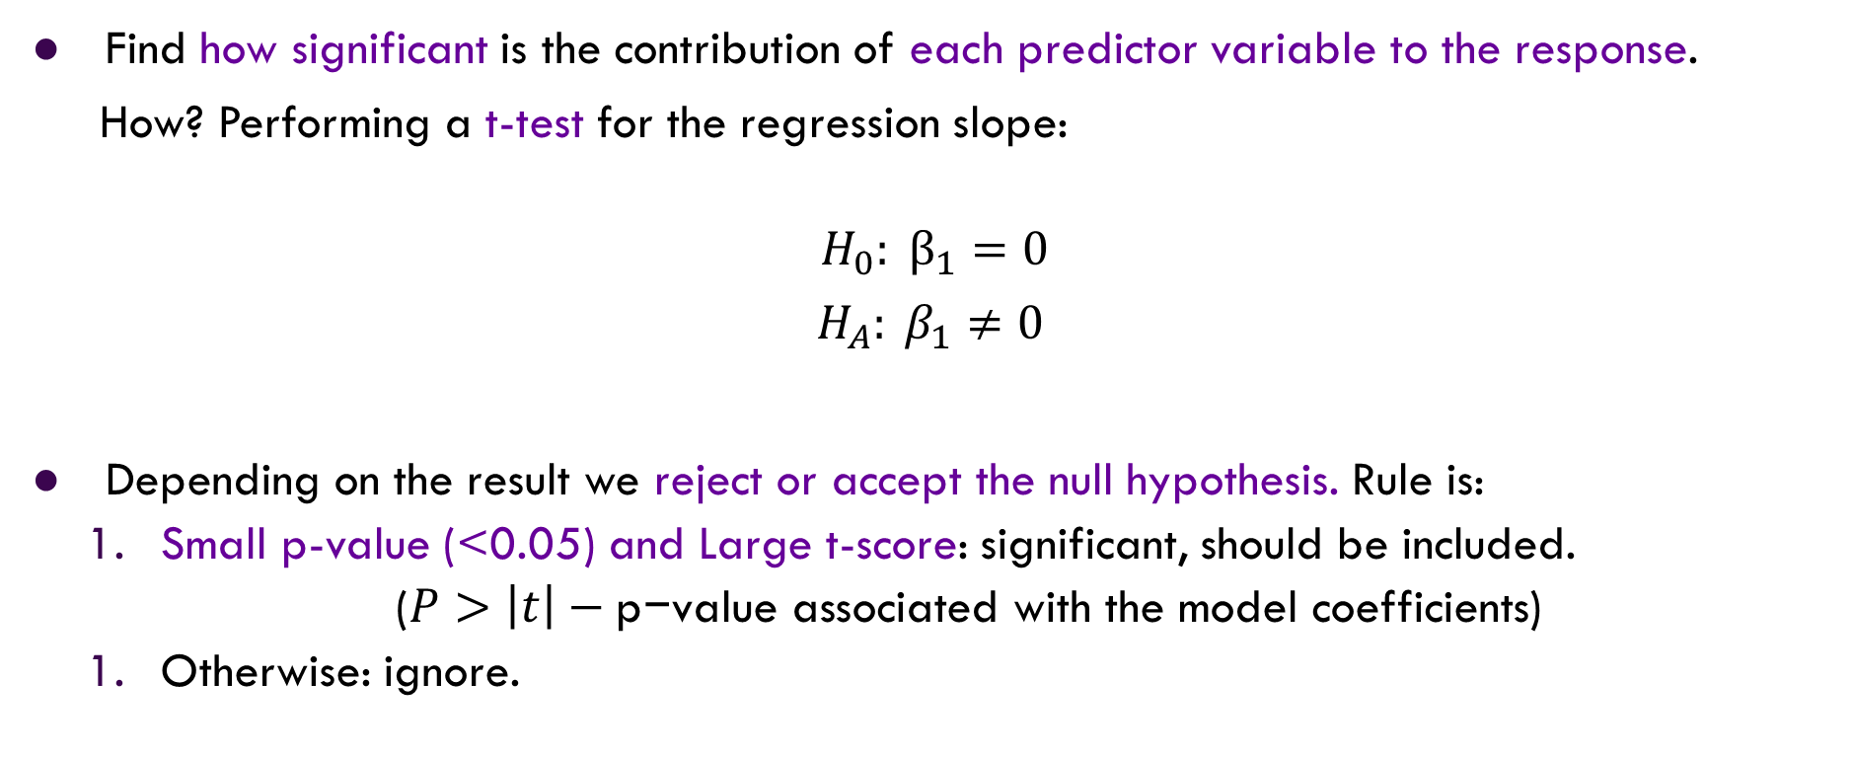
Measures of variable importance
Find how significant is the contribution of each predictor variable to the response.
How? Performing a t-test for the regression slope:
$$H_{0}: β_{1}=0$$
${ H}_{A}: β_{1}≠0$
Depending on the result we reject or accept the null hypothesis. Rule is:
Small p-value (<0.05) and Large t-score: significant, should be included.
($P>\left|t\right|−\text{p}\text{−}\text{value} \text{associated} \text{with} \text{the} \text{model} \text{coefficients}$)
Otherwise: ignore.
zero slope means change in the predictor variables don’t impact changes in the response
The p-value serves as an alternative to rejection points to provide the smallest level of significance at which the null hypothesis would be rejected

Slide 10
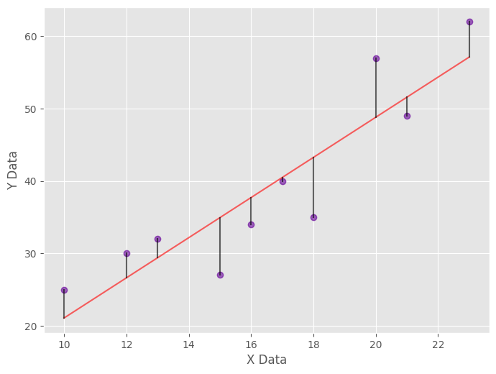
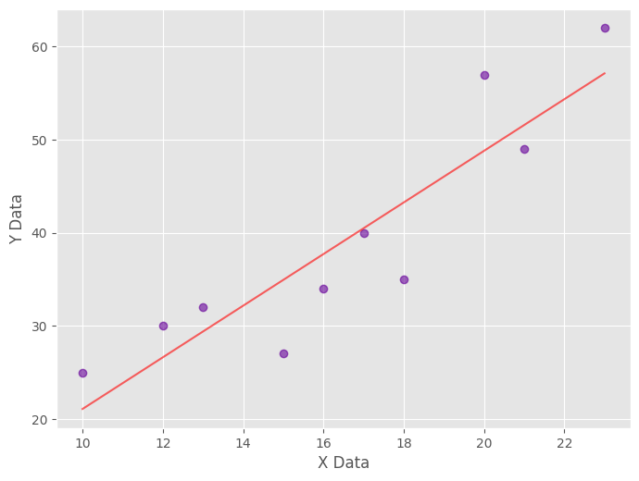
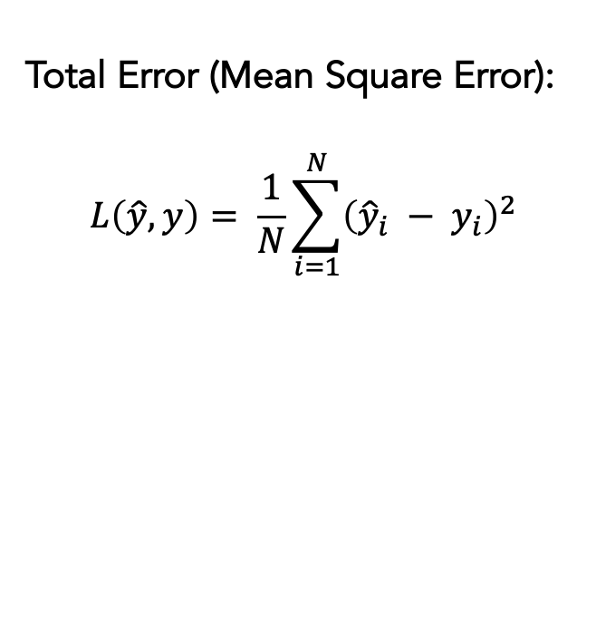

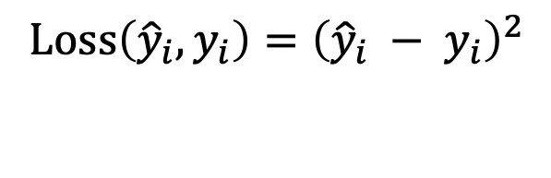

Finding Optimal Line
Approach:
Find the line which generate minimal error
Error:
Difference between predicted value and true value (residuals)
Total Error (Mean Square Error):
$$L\left(\hat{y}, y\right)= \frac{1}{N}\sum_{i=1}^{N}{{\left({\hat{y}}_{i} − y_{i}\right)}^{2}}$$
$${\hat{y}}_{i}$$
$$y_{i}$$
$$Loss\left({\hat{y}}_{i}, y_{i}\right)={\left({\hat{y}}_{i} − y_{i}\right)}^{2}$$

Slide 11
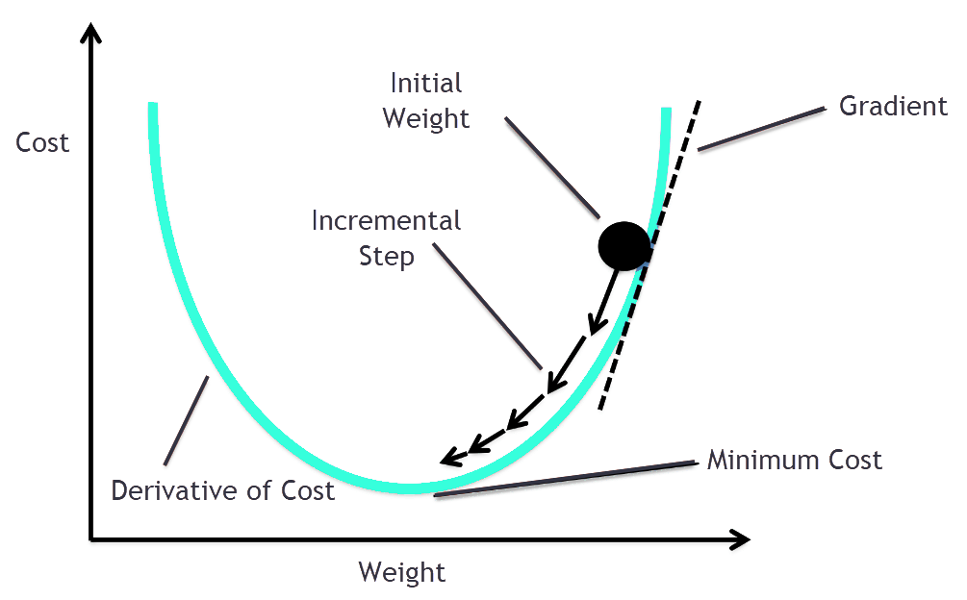
How to Minimize Error?
Solution: Gradient Descendent
Gradient (Derivatives) measures How the function’s output will change if we change the input a bit
It can guide us to the function’s local minimum:
Minimizing Error Function’s output!

Slide 12
Model Construction
Linear Regression Model
1. Use Linear Regression to model the relationship between feature data
2. Use Mean Square Error as Loss Function
3. Use Gradient Descendent as optimization Method
How to test model’s performance and evaluate it?
Error Evaluation: Mean Square Error Loss function
Optimization Method: Gradient Descendent
Relation Modeling: Linear Regression

Slide 13
Performance Evaluation
Data Preparing & Splitting
Model Training
1. Split dataset into three parts: Training data, Test data and Validation data
2. Use Training Data to build the model
3. Use Test Data to check model’s performance
4. Finally make prediction on Validation Data
Linear Regression Model
The
Machine
Learning
Pipeline
Error Evaluation: Mean Square Error Loss function
Optimization Method: Gradient Descendent
Relation Modeling: Linear Regression
Model Evaluation
Evaluate Model using validation data

Slide 14
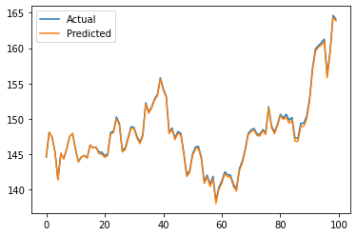

Slide 15
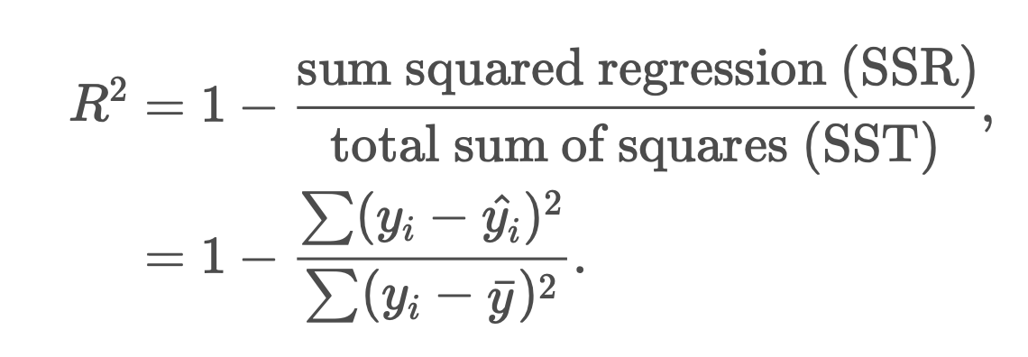
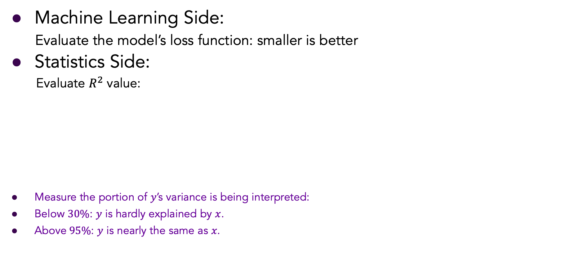
Performance Evaluation
Machine Learning Side:
Evaluate the model’s loss function: smaller is better
Statistics Side:
Evaluate $R^{2}$ value:
Measure the portion of $y$’s variance is being interpreted:
Below $30\%$: $y$ is hardly explained by $x$.
Above$95\%$: $y$ is nearly the same as $x$.
Mean

Slide 16
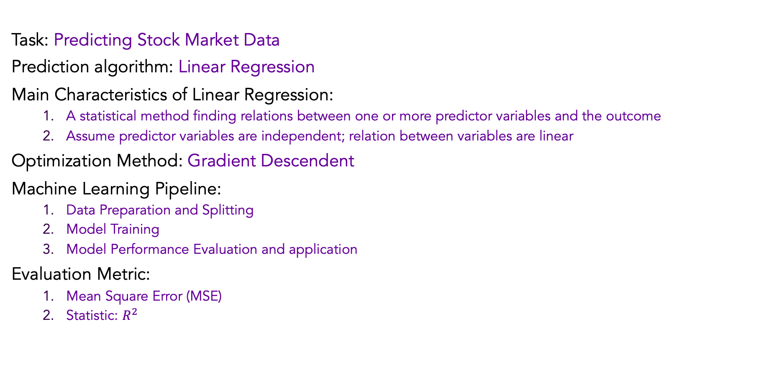
Summary
Task: Predicting Stock Market Data
Prediction algorithm: Linear Regression
Main Characteristics of Linear Regression:
A statistical method finding relations between one or more predictor variables and the outcome
Assume predictor variables are independent; relation between variables are linear
Optimization Method: Gradient Descendent
Machine Learning Pipeline:
Data Preparation and Splitting
Model Training
Model Performance Evaluation and application
Evaluation Metric:
Mean Square Error (MSE)
Statistic: $R^{2}$

Slide 17
Thanks

